Slide 1


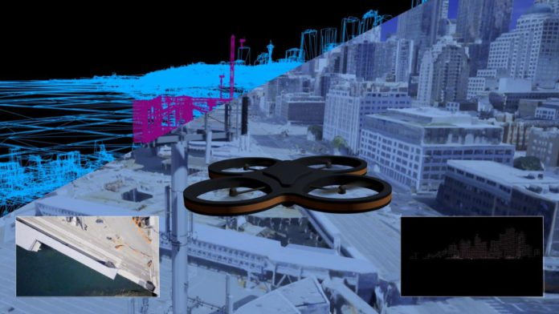
Multiple Drone Coordination Project Proposal
Group 32
Brenden Martins - Simulation Management Subsystem
Matthew Paternoster - User Interface Subsystem
Matthew Wyatt - Data Management and Communication Subsystem
Tutku Gizem - Target Detection Subsystem
Tarek Kayali - Drone Control Subsystem

Slide 2
Introduction
These challenges include, but are not limited to, human safety risks, limited drone coordination systems, and inefficient testing environments for the drones. We plan to address these challenges by providing a scalable and efficient MDCS, which can increase the positive outcomes for areas that are facing disaster scenarios.
Our objective is to develop a system for coordinating multiple drones in a realistic 3D simulation environment, which is in response to the growing challenges current emergency response systems face in disaster ridden areas.

Slide 3
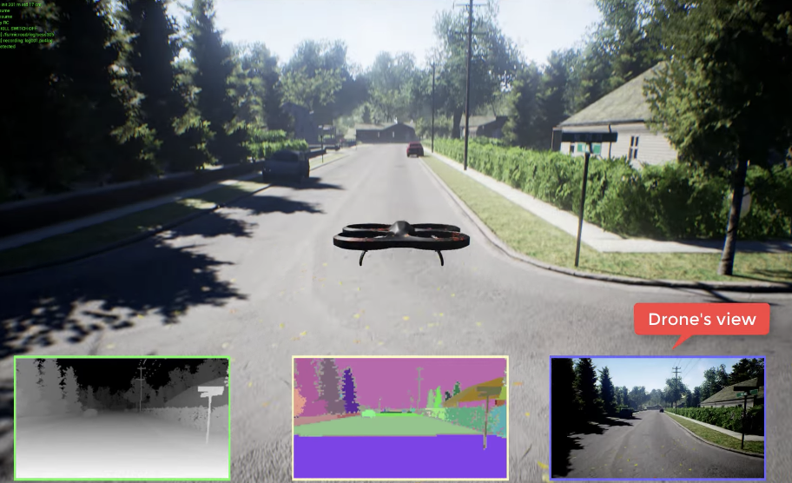
Proposed Solution
Our Project aims to solve some of these challenges by developing a system for coordinating multiple drones in realistic simulated environment to carry out tasks like target detection and rescue operations.
https://production-media.paperswithcode.com/datasets/Screen_Shot_2021-01-29_at_11.03.21_AM.png

Slide 4

Functional Description
Speaking: Matthew Wyatt
MDCS Capabilities:
Real-time coordination of multiple drones for tasks such as victim identification, hazard monitoring, and resource delivery.
Dynamic task assignment and collision avoidance to ensure safe and efficient operations.
User Interaction:
Operators use a mobile interface to monitor drone statuses, plan missions, and receive real-time data.
Drones autonomously execute missions based on predefined algorithms and user inputs.

Slide 5

End-User Experience
Speaking: Matthew Paternoster
Example Scenario:
Description: In a hurricane scenario, multiple drones are deployed to perform a coordinated rescue mission. The user initiates the mission through the User Interface Subsystem, specifying the affected area and objectives.
State Transitions:
Initialization → Idle: System starts and awaits mission commands.
Idle → Mission Planning: User initiates the rescue mission.
Mission Planning → Mission Execution: Mission parameters are set, and drones are deployed.
Mission Execution → Idle: Rescue mission is successfully completed, and drones return to idle state.
Detailed Flow:
User inputs mission details via the interface.
System assigns tasks to each drone based on their capabilities and positions.
Drones navigate to designated locations, avoiding obstacles and coordinating with each other.
Upon successful completion, drones report back, and
the system updates the mission status to completed.
Operators:
Launch and manage multiple drones from a centralized mobile application.
Visualize real-time data on maps, including drone locations and detected targets.
First Responders:
Receive actionable insights from drone surveillance to make informed decisions.
Utilize drone-collected data for strategic planning and resource allocation during disasters.

Slide 6
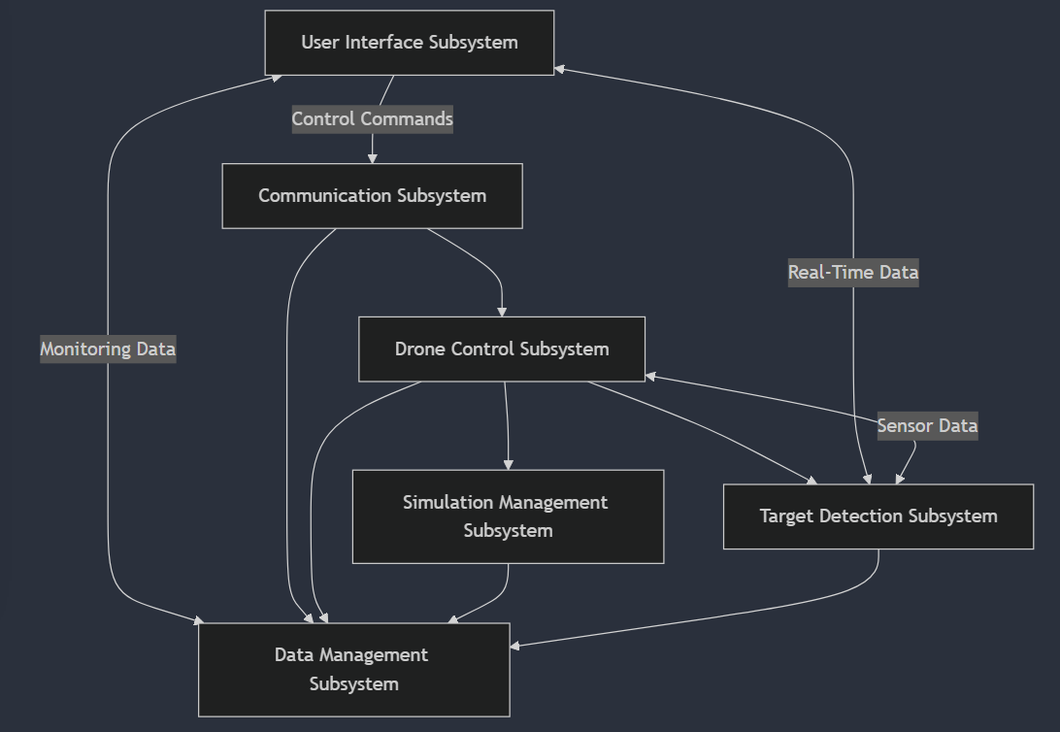
System Architecture
Speaking: Matthew Paternoster
System Components:
Simulation Management Subsystem: Creates and maintains the 3D environment.
Drone Control Subsystem: Manages drone navigation and coordination.
Target Detection Subsystem: Processes sensor data to identify targets.
User Interface Subsystem: Provides real-time monitoring and control via mobile devices.
Data Management Subsystem: Handles data storage and processing.
Communication Subsystem: Ensures reliable data exchange between drones and control systems.

Slide 7
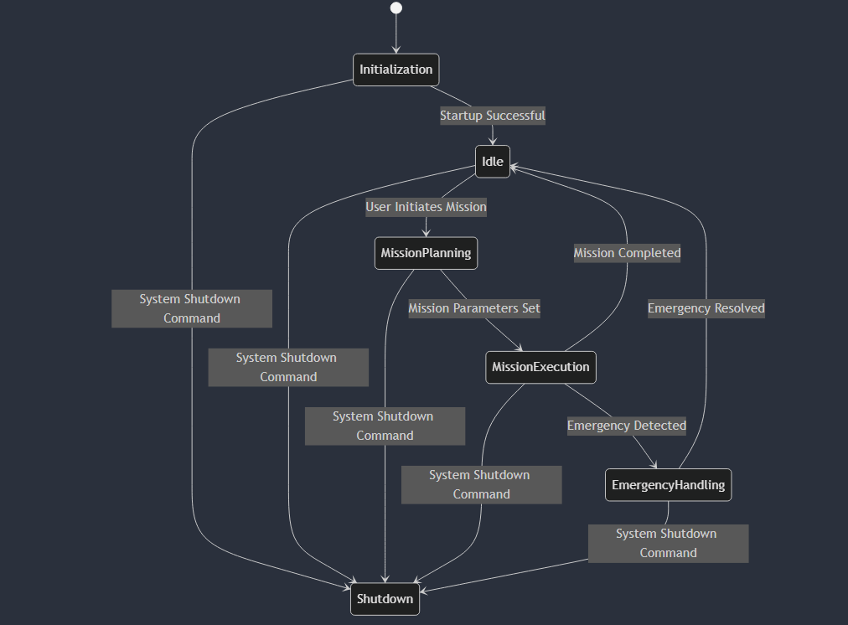
System State Diagram
Speaking: Matthew Wyatt
States:
Initialization: System startup phase.
Idle: System is waiting for user input or missions.
Mission Planning: Configuring mission parameters.
Mission Execution: Active phase where drones carry out the mission.
Emergency Handling: Managing unexpected emergencies during missions.
Shutdown: System is powering down.
Transitions:
Initialization → Idle: Upon successful startup.
Idle → Mission Planning: When a user initiates a mission.
Mission Planning → Mission Execution: After mission parameters are set.
Mission Execution → Emergency Handling: If an emergency is detected during execution.
Mission Execution → Idle: Upon successful mission completion.
Emergency Handling → Idle: After resolving the emergency.
Any State → Shutdown: When a shutdown command is received.

Slide 8
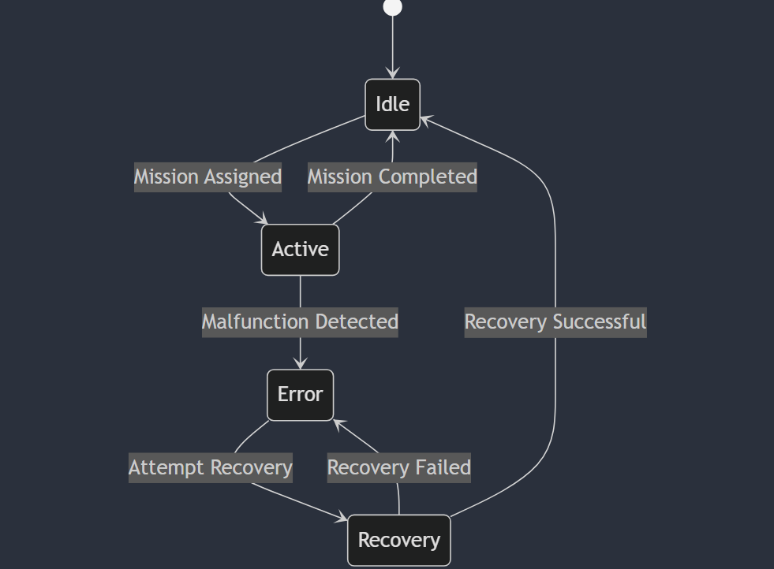
Subsystem State Diagram
States:
Idle: Waiting for mission assignments.
Active: Currently executing a mission.
Error: A malfunction or anomaly has been detected.
Recovery: Attempting to resolve the error.
Transitions:
Idle → Active: When a mission is assigned.
Active → Idle: Upon mission completion.
Active → Error: If a malfunction is detected during mission execution.
Error → Recovery: When attempting to fix the issue.
Recovery → Idle: If recovery is successful.
Recovery → Error: If recovery fails and the system remains in an error state.

Slide 9
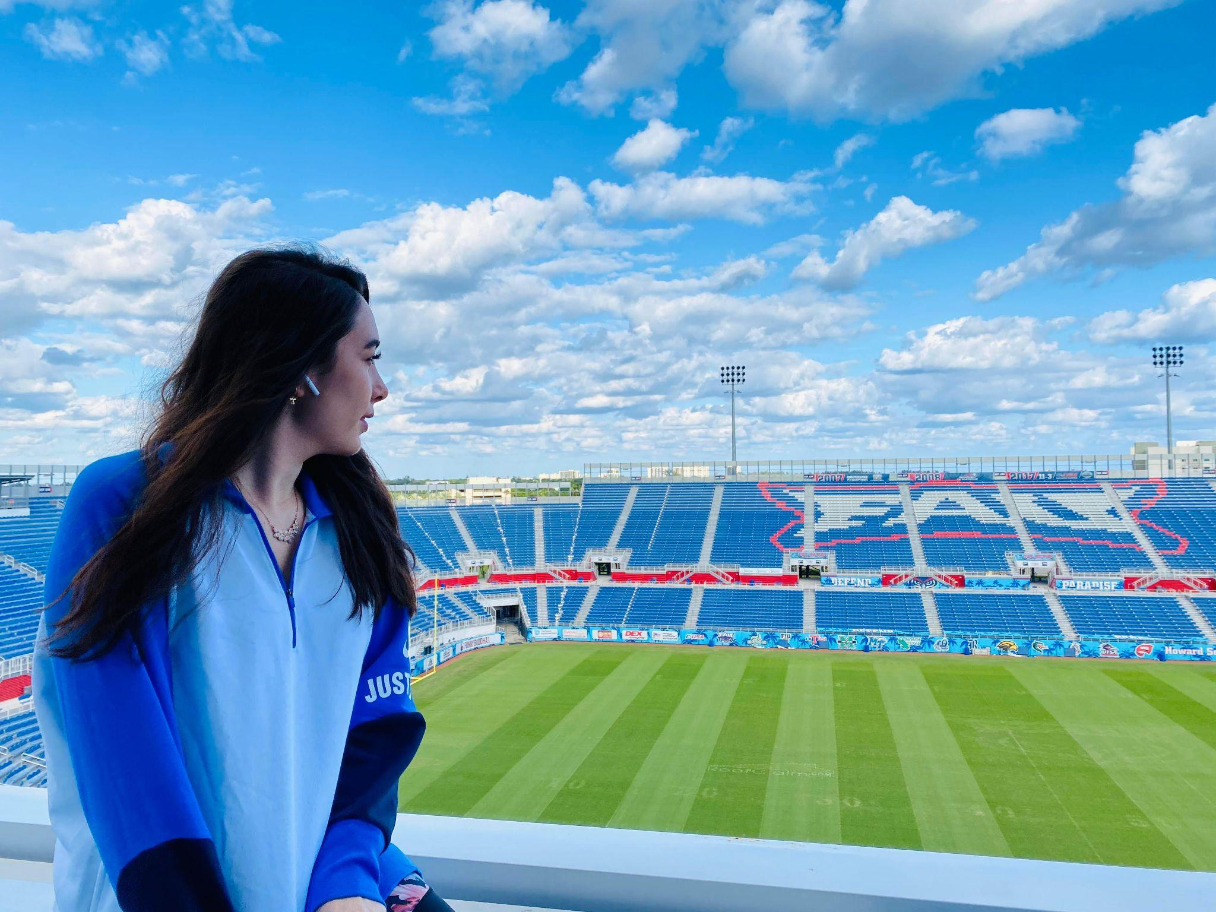
Target Detection Subsystem
Speaking: Tutku Gizem Guder
Interfaces to Other Subsystems:
Provides data about identified targets to Drone Control Subsystem.
Interacts with Data Management Subsystem for storing target data.
Detected target data (location, type, etc.) is transmitted to the User Interface,
Implementation Challenges:
Known: Sensor Integration, Model Training
Unknown: Real-World Testing Variability, Processing Load
Early Prototype Implementation:
Simulation environment created.
It’s on the process of integration of the model to the environment.
Components:
Sensors
Machine Learning Model
Processing Hardware
Component Selection Justification:
High-performance hardware ensures smooth simulation rendering.
ML model is chosen ensuring that the drones can identify targets quickly and accurately with minimal delay, critical for mission success in dynamic environments.

Slide 10
Drone Control Subsystem
Components:
UAV Platforms (simulated)
Flight Controllers (simulated)
Control Algorithms (C++)
Component Selection Justification:
Simulated UAVs allow for extensive testing without hardware costs.
C++ ensures high performance for real-time control.
Interfaces to Other Subsystems:
Communicates with Simulation Management and Target Detection Subsystems.
Receives commands from Communication Subsystem.
Implementation Challenges:
Known: Implementing robust collision avoidance.
Unknown: Scaling control algorithms for a large number of drones.
Early Prototype Implementation:
Basic navigation algorithms implemented.

Slide 11
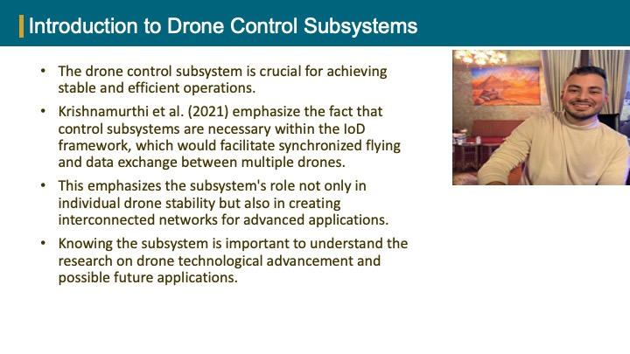

Slide 12
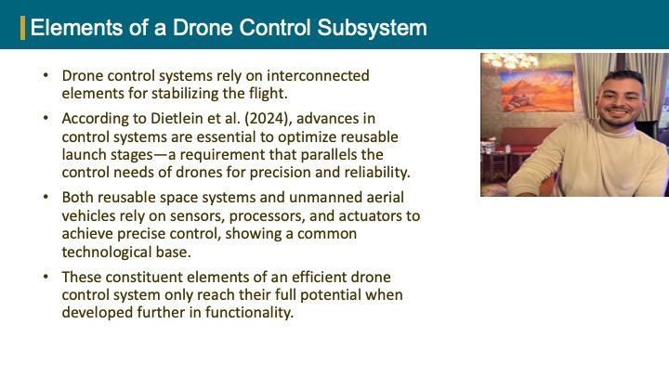

Slide 13
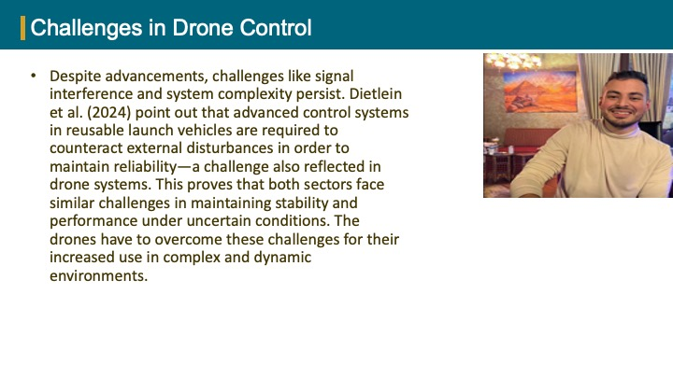

Slide 14

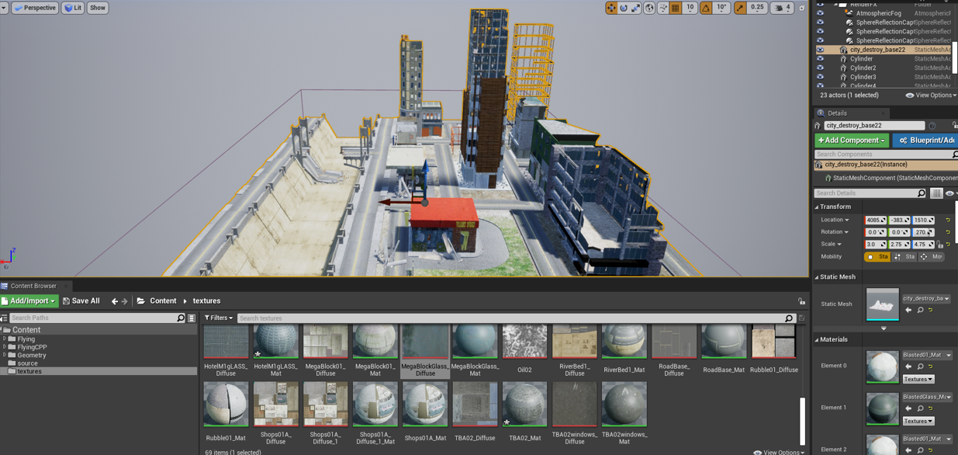
Simulation Management Subsystem - Overview
Subsystem Role
Hub for simulating disaster ridden areas and providing real time data to other subsystems.
Purpose
Create and manage a realistic 3D simulation environment for drone operations and testing.
Models environmental factors to enable comprehensive testing of MDCS.
Key Features
Customizable Simulation Parameters:
Disaster type, terrain settings, and environmental variables.
Dynamic Environmental Modeling:
Real-time weather effects (e.g., wind, rain).
Complex terrain generation and obstacle placement.

Slide 15
Simulation Management Subsystem - Interface Interactions
Interfaces with Other Subsystems
Drone Control Subsystem:
Provides terrain, weather, and obstacle data for UAV navigation and coordination.
Target Detection Subsystem:
Supplies environmental details to improve target identification accuracy.
Data Management Subsystem:
Sends simulation state data for storage and analysis.
User Interface Subsystem:
Allows operators to configure simulation parameters and monitor environmental changes.
Flow of Information
Input: Parameters from the User Interface Subsystem.
Output: Real-time environment data for other subsystems to ensure seamless operations.

Slide 16
Simulation Management Subsystem - Challenges and Implementations
Challenges
Known Challenges:
Complex terrain generation to ensure diversity and realism.
Real-time weather simulation without compromising system performance.
Balancing scalability with computational efficiency for large simulations.
Unknown Challenges:
Integrating dynamic obstacle placement with real-time drone operations.
Unforeseen performance bottlenecks during multi drone simulations.
Prototype Implementation
Completed:
Basic environment with static terrain and pre-configured weather.
In Progress:
Dynamic weather simulation and obstacle placement modules.
Real-time data streaming to other subsystems.

Slide 17
User Interface Subsystem
Speaking: Matthew Paternoster
Components:
Desktop Application (Electron)
Real-Time Data Display
Component Selection Justification:
Electron facilitates seamless integration with Microsoft AirSim, allowing for efficient data exchange and control.
Intuitive design enhances usability for operators, providing a responsive and user-friendly interface on desktop platforms.
Interfaces to Other Subsystems:
Receives data from Data Management and Target Detection Subsystems.
Sends control commands via Communication Subsystem.
Implementation Challenges:
Known: Designing an intuitive and responsive interface.
Unknown: Handling real-time data efficiently within the Electron framework to ensure smooth performance.

Slide 18
Data Management Subsystem
Speaking: Matthew Wyatt
Components:
Database Servers
Storage Solutions
Component Selection Justification:
Database Servers: Chosen for their ability to store and manage large volumes of operational data securely.
Storage Solutions: Selected for their scalable data storage capabilities, supporting real-time access and archival.
Interfaces to Other Subsystems:
Interfaces with Communication Subsystem for data exchange.
Interfaces with User Interface Subsystem for data access.
Implementation Challenges:
Ensuring data integrity and security.
Managing large volumes of real-time data.
Setting up database tables once data is available.

Slide 19
Communications Subsystem
Speaking: Matthew Wyatt
Components:
Wireless Communication Modules
Network Infrastructure
Component Selection Justification:
Wireless Communication Modules: Facilitate reliable data exchange between drones and control systems.
Network Infrastructure: Ensures stable connectivity and low-latency communication.
Interfaces to Other Subsystems:
Interfaces with Data Management Subsystem for data exchange.
Interfaces with User Interface Subsystem for user interactions.
Implementation Challenges:
Ensuring stable and low-latency communication.
Handling multiple simultaneous user sessions.
Implementing robust authentication mechanisms (MFA and RBAC).

Slide 20
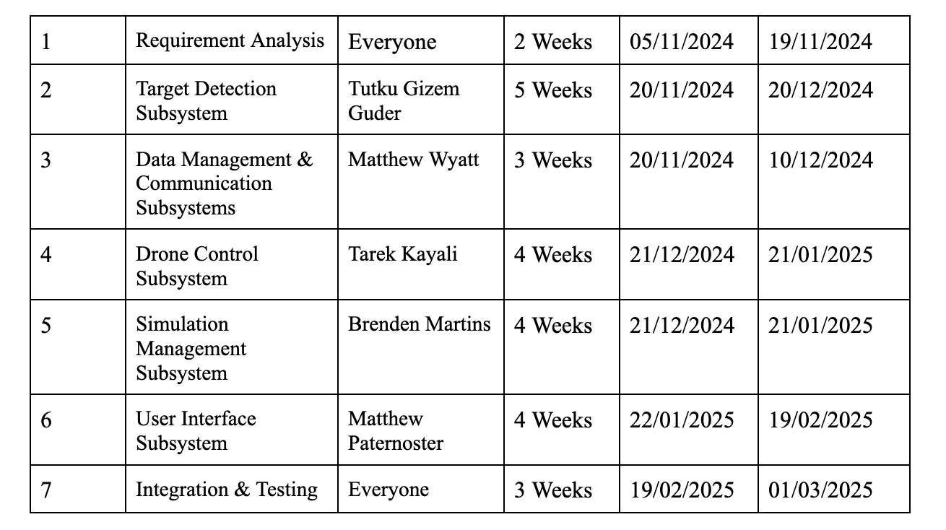
Task Distribution Between the Team
Speaking: Tutku Gizem Guder

